Slide 1
SOEN 384
Management, Measurement and Quality Control http://users.encs.concordia.ca/~s384_2/
Lecture 4:
Goal-based software measurement (Goal-Question-Metric - GQM)
References:
Fenton’s book “3.2.1 Goal-Question-Metric paradigm” (download Chapter 3 from the library course reserve link)

Slide 2
Agenda for today
Review
Goal-based framework for software measurement
Simple project measurements
Next?
soen384-F15-L4: GQM

Slide 3
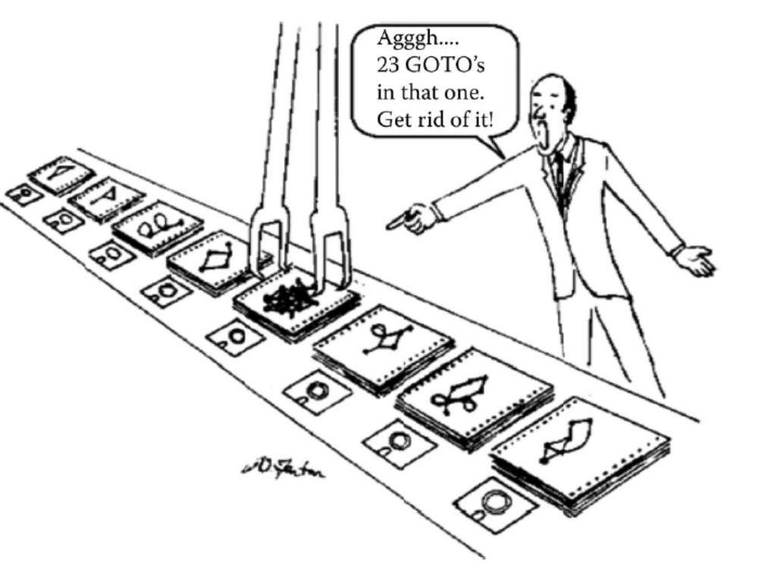
McCabe metrics and OO Metrics - key measurements used to identify latent code risks
soen384-F15-L4: GQM

Slide 4
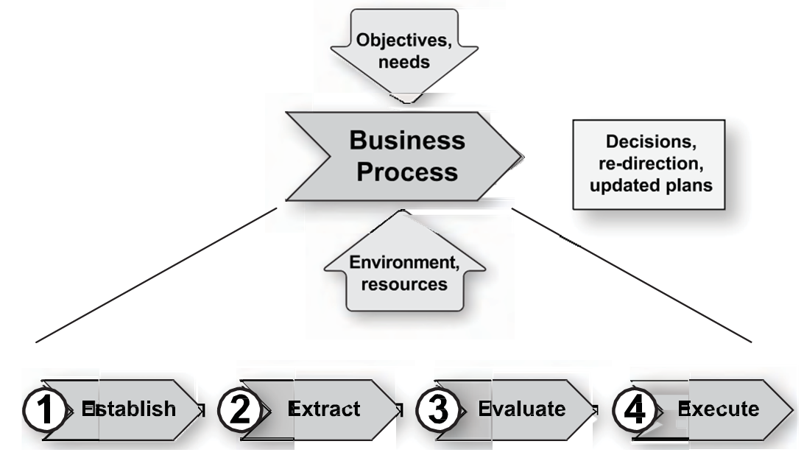
A Generic Measurement Feedback Loop
Software Project and Process Measurement, Dr. Christof Ebert
Vector Consulting Services
soen384-F15-L4: GQM
Notes:
The underlying purpose of any measurement program, must be to achieve specific results from the use and application of the measures; collecting data is not the objective. Most failed measurement programs suffer from inadequate or unclear use of data, not
from an inadequate or unclear data collection process. The rule implies that the
measurement program must be defined in a way that satisfies specific objectives. Without such
objectives, no benefit will be derived from the measurement effort.

Slide 5
Steps of the Measurement Feedback Loop
HOW?
Establish
  concrete improvement or control objectives and the necessary measurement activities.
Extract
  Extract information (collect measurement data) for a specific need and record it for potential further usage.
Evaluate
  Use the extracted measurement data on the spot!
  Statistical analysis and evaluation
Execute
  Execute decisions and actions to reduce the differences between status and objectives.
  Management decisions are directly linked to the specific need of the stakeholder
soen384-F15-L4: GQM
Notes:
clear focus on
goal-oriented measurement and execution
of decisions at the end of the four steps.

Slide 6
Agenda for today
Review
Goal-based software measurement
Simple project measurements
Next?
soen384-F15-L4: GQM

Slide 7
Establish and Sustain Measurement Commitment
Each measurement endeavor should be guided by organizational objectives and driven by a set of measurement requirements established by the organization and the project:
Commitment of management and staff to measurement.
Commit resources for measurement.
soen384-F15-L4: GQM

Slide 8

Measurement Stakeholders and their Goals
    Senior manager: needs figures on the business performance
    Project manager: needs timely and accurate information on project’s parameters
    Individual Engineer: wants to improve its own performance and thus looks into quality of the deliverables. Concentrates on the team’s objectives
    Customers: "In data we trust"
      Certification of software components.
      Maturity of organization CMM (I).
soen384-F15-L4: GQM

Slide 9
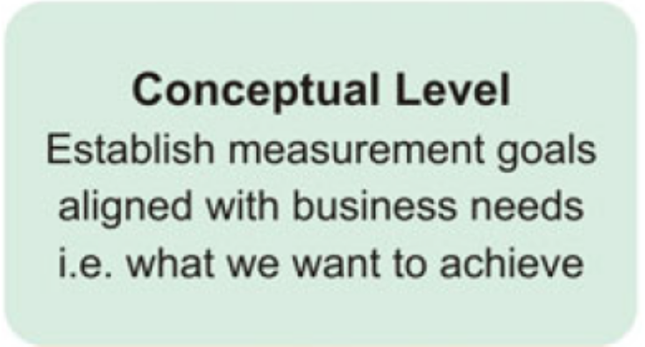
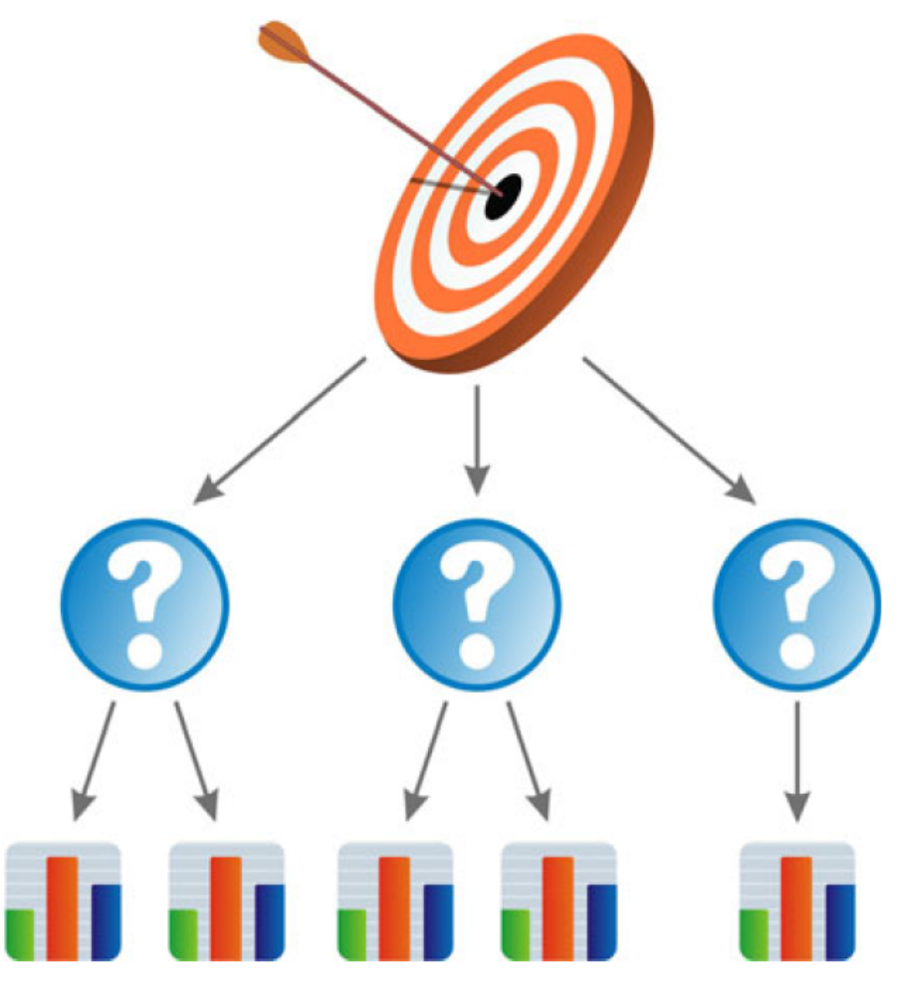
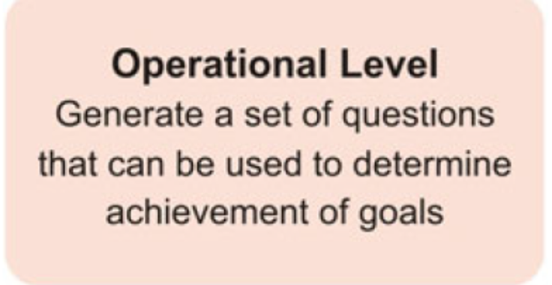
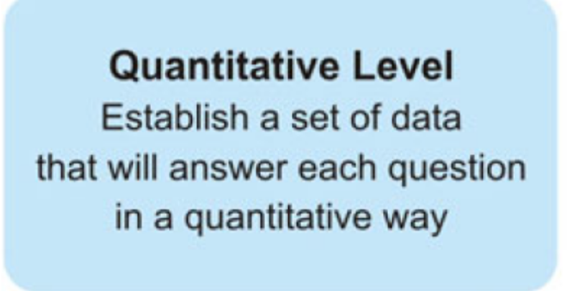
Establishing and Sustaining Measurement Commitment :
Goal Question Metrics (GQM) Approach
soen384-F15-L4: GQM

Slide 10
GQM: Set Realistic and Measurable Project Quality Goals
Project goals should be clear and tangible:
BAD
  reduce errors
  improve quality by 50 percent
GOOD:
  Reduce the number of late projects by 50 percent for this year compared to the previous year.
soen384-F15-L4: GQM
Notes:
Goals that are measured will be
achieved.
As humans—and specifically
as engineers—we want to deliver
results. Measurement provides the stimulus
and direction to reach our goals

Slide 11
Establishing and Sustaining Measurement Commitment :
Goal Question Metrics (GQM) Approach
  Set goals specific to needs
    Goals that are measured will be achieved.
  Refine the goals into quantifiable questions that are tractable.
  Deduce the metrics and data to be collected (and the means for collecting them) to answer the questions.
soen384-F15-L4: GQM
Notes:
Managers proceed according to the above three stages

Slide 12

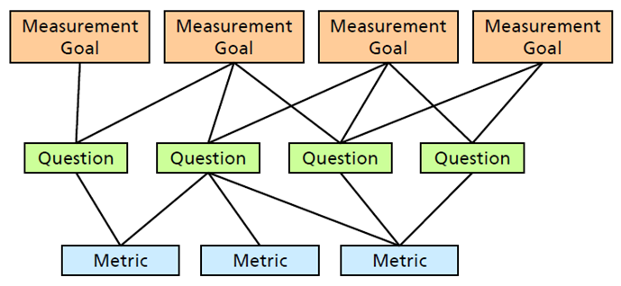
Goal-Question-Metric (GQM) Structure
soen384-F15-L4: GQM

Slide 13
GQM Simple Example 1
Goal: to evaluate the effectiveness of the organization’s coding standards
Question1: What is the productivity of the coders?
Measurement Formula1:
  Productivity = Code Length / Actual Effort
Metrics: Code length, Actual Effort
soen384-F15-L4: GQM
Notes:
NOTE: IEEE Std.1045-1992 for Software Productivity Metrics:
The definition of productivity is the ratio of product size to effort expended to produce it

Slide 14
Steps of the Measurement Feedback Loop
Establish
  concrete improvement or control objectives and the necessary measurement activities.
Extract
  Extract information (collect measurement data) for a specific need and record it for potential further usage.
Evaluate
  Use the extracted measurement data on the spot!
  Statistical analysis and evaluation
Execute
  Execute decisions and actions to reduce the differences between status and objectives.
  Management decisions are directly linked to the specific need of the stakeholder
Length in SLOC,
Effort in person-minutes
(Done in Homework 1)
soen384-F15-L4: GQM
Notes:
clear focus on
goal-oriented measurement and execution
of decisions at the end of the four steps.

Slide 15

Goal-Question-Metric (GQM) Structure
soen384-F15-L4: GQM

Slide 16
Steps of the Measurement Feedback Loop
Establish
  concrete improvement or control objectives and the necessary measurement activities.
Extract
  Extract information (collect measurement data) for a specific need and record it for potential further usage.
Evaluate
  Statistical analysis and evaluation
Execute
  Execute decisions and actions to reduce the differences between status and objectives.
  Management decisions are directly linked to the specific need of the stakeholder
(Homework 2)
soen384-F15-L4: GQM
Notes:
clear focus on
goal-oriented measurement and execution
of decisions at the end of the four steps.

Slide 17
Homework 2 in context: Perform Coding Productivity analysis
use a control chart to analyse and interpret the coding productivity data
  if the dataset has a normal distribution, then we can generate the upper and lower control limits as a factor of ±3 times the standard deviation. If a point resides outside of the control limits, it will be considered for further investigation.
  Otherwise, employ an appropriate transformation to this non-normal dataset. The result of such a mathematical transformation will transform the non-normal dataset collected into a normally distributed dataset. We can use this normalized data in a control chart to evaluate our decision criteria.
Generate a control chart.
Interpret the data for decision-making (RE: ISO 15939 productivity measurement model, Appendix 2, page 25)
soen384-F15-L4: GQM

Slide 18
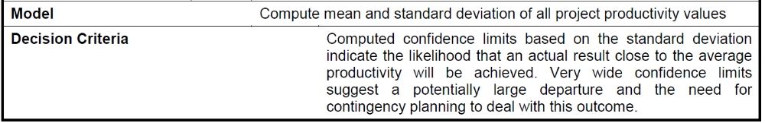
Homework 2 in context: Interpret the results (RE: ISO 15939 productivity measurement model, Appendix 2, page 25)
soen384-F15-L4: GQM

Slide 19
Steps of the Measurement Feedback Loop
Establish
  concrete improvement or control objectives and the necessary measurement activities.
Extract
  Extract information (collect measurement data) for a specific need and record it for potential further usage.
Evaluate
  Statistical analysis and evaluation
Execute
  Execute decisions and actions to reduce the differences between status and objectives.
  Management decisions are directly linked to the specific need of the stakeholder
soen384-F15-L4: GQM
Notes:
clear focus on
goal-oriented measurement and execution
of decisions at the end of the four steps.

Slide 20
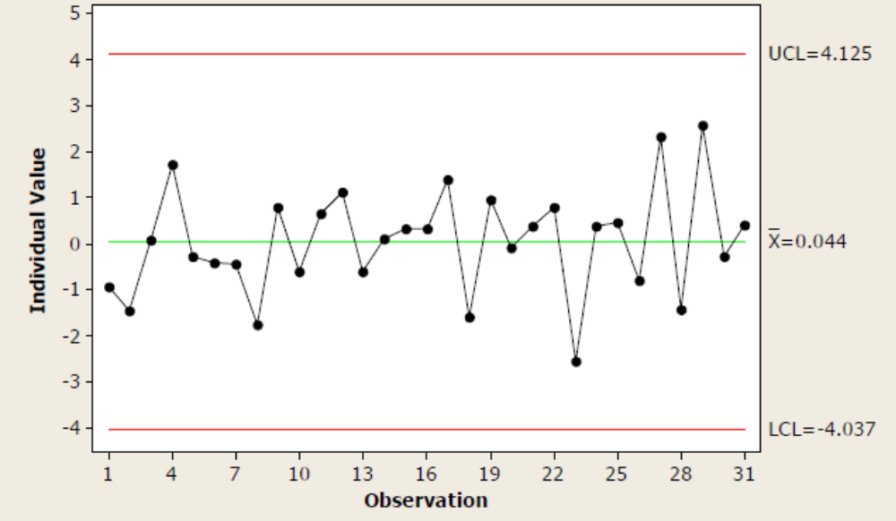
Homework 2 in context: Perform Coding Productivity analysis
Sample Homework 2 chart from previous years:
  All data points are within the control limits we can conclude that there are no developers with an unusually low or high productivity.
soen384-F15-L4: GQM

Slide 21
Homework 2 in context: What kind of problems with the above measurement of productivity may arise?
Two typical managerial problems are listed below:
The more verbose the programmer, the more productive.
The lower the programming language, the higher is productivity.
soen384-F15-L4: GQM

Slide 22
GQM Simple Example 1 (continued)
Goal: to evaluate the effectiveness of the organization’s coding standards
Question2: What is the quality of the code?
Measurement Formula2:
  Defect Density = #Defects / Code Length
Metrics: Code length, #Defects
soen384-F15-L4: GQM

Slide 23
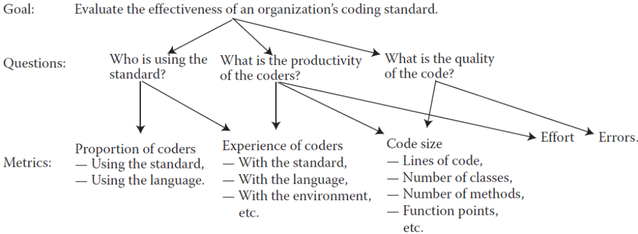
GQM Example 1: Compete solution
(see Fenton’s book, Figure 3.2, p.101)
soen384-F15-L4: GQM

Slide 24
GQM: example 3
The project manager in this example needs to know past developers productivity in similar projects to estimate the number of developers required for a new similar project.
  This example assumes that historical data on past projects is available:
  coders productivity data needs to be collected for every past project, and the average productivity computed for each project in the data store
soen384-F15-L4: GQM

Slide 25
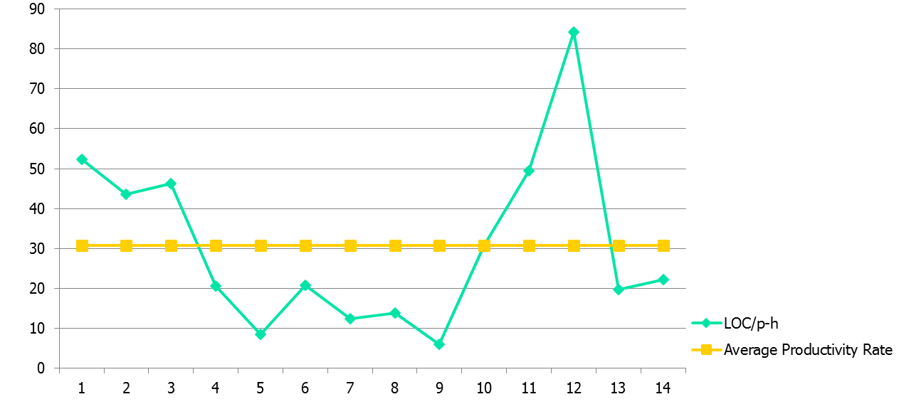
analysis report
Productivity analysis:
soen384-F15-L4: GQM
Notes:
analysis report

Slide 26
Steps of the Measurement Feedback Loop
Establish
  concrete improvement or control objectives and the necessary measurement activities.
Extract
  Extract information (collect measurement data) for a specific need and record it for potential further usage.
Evaluate
  Use the extracted measurement data on the spot!
  Statistical analysis and evaluation
Execute
  Execute decisions
Estimate the number of developers
soen384-F15-L4: GQM
Notes:
clear focus on
goal-oriented measurement and execution
of decisions at the end of the four steps.

Slide 27
Example of a decision making:
Average productivity: 30 SLOC/person-hour
Estimated output (length of the code to be produced, given to the manager): 2400 SLOC
Schedule? Estimated Effort?
  Fixed schedule: 2 weeks
  Estimated effort?
  2400 SLOC / 30 SLOC/person-hour = 80 person-hour
How many developers?
  Effort per developer for 2 weeks:
    4h/day x 5 days/week x 2 weeks = 40 h
  Number of developers =
  80 person-hour / 40 h = 2 person (developers)
It is very important to have a precise effort estimation!

Slide 28
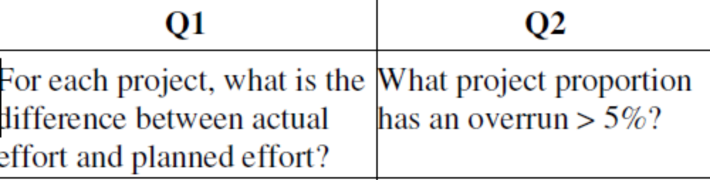
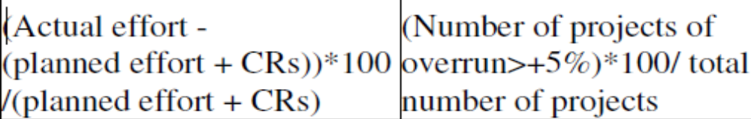
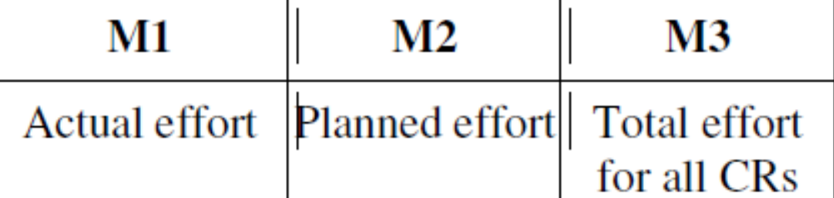
More complex example of GQM
G1: deliver projects within effort estimates
Measurement formulas, one per question
CR=
Change Request
soen384-F15-L4: GQM

Slide 29
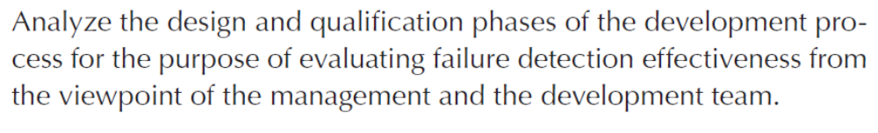
Template for Goal Definition
Purpose:
  To characterize, evaluate, predict, etc.) the (process, product, model, etc.) in order to (assess, improve, etc.) it.
Perspective:
  Examine the (cost, effectiveness, quality, etc.) from the viewpoint of the (developer, customer, manager, etc.)
Environment:
  Process, people, tools, constraints, etc.
soen384-F15-L4: GQM

Slide 30
Commonly Collected Project Measurement Data
(IMPORTANT!!!!)
Functional Size (ex.: COSMIC function points CFP ) or Code Length (ex.: SLOC)
Effort (Estimated v.s. Actual)
Defects
Resources
soen384-F15-L4: GQM

Slide 31
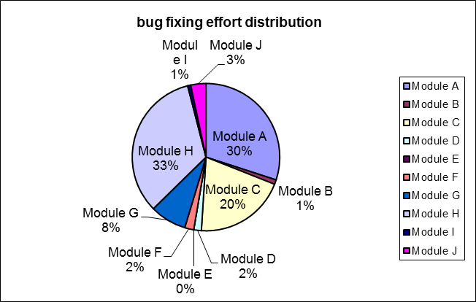
Examples of commonly used measurements
Productivity= length / effort
Defect Density = #defects / length
Estimated Effort =
Percentage of the total effort to fix bugs required to resolve the defects fixed in each module per Sprint
a * CFP ^{b}
 | Modules | bug fixed | effort (p-h)
 | Module A | 11 | 45
 | Module B | 3 | 1.5
 | Module C | 13 | 30
 | Module D | 1 | 2.5
 | Module E | 0 | 0
 | Module F | 2 | 3
 | Module G | 1 | 12
 | Module H | 14 | 50
 | Module I | 2 | 1
 | Module J | 3 | 5
 |  | 50 | 150
soen384-F15-L4: GQM
Notes:
Software A has 100 defects
Software B has 1 defect.
Can we compare A and B?
More: A has 10,000 lines of code and B has 10 lines of code
=> Defect Density (A) < Defect Density (B)

Slide 32
Key benefits from measurements
FEEDBACK
  Do not create data cemeteries (a.k.a. useless overhead)
  Figures are not “made up” for reports, they are a normal (self-) management tool.
  It is about People not Numbers!
soen384-F15-L4: GQM

Slide 33
Next?
More on software project measurements.
Sample software project measurement program
soen384-F15-L4: GQM

Slide 34
Questions?
...
soen384-F15-L4: GQM

